Slide 1


Home Management Service
Mini-Project Report
Submitted in partial fulfillment of the requirement of the degree Bachelor of Computer Applications of
Mahatma Gandhi University
Kottayam
BY
Seethal V.S
Reg. No:210021091499
Under the guidance of
Ms. Anjana RR
(Asst. Professor, Department of Computer Applications)
SNGIST ARTS & SCIENCE COLLEGE
NORTH PARAVUR-683 511

Slide 2
Home Construction Services
Mini-Project Report
Submitted in partial fulfillment of the requirement of the degree Bachelor of Computer Applications of
Mahatma Gandhi University
Kottayam
BY
Seethal V.S
Reg. No:210021091499
Under the guidance of
Ms. Anjana RR
(Asst. Professor, Department of Computer Applications)
SNGIST ARTS & SCIENCE COLLEGE
NORTH PARAVUR-683 511

Slide 3


Date
………….
CERTIFICATE
This is to certify that the project titled "HOME" done at LCC Project Center, Aluva, submitted by Seethal V.S with Reg. No. 210021091499 in partial fulfillment of the requirement of Bachelor of Computer Applications of SNGIST Arts & Science College , affiliated to Mahatma Gandhi University during 2021 - 2024 , is a record of the bonafide work done by him/her under our supervision and guidance.
Anjana RR
Internal Guide
Safeer
Head of the Department
Submitted for the Viva-Voce Examination held on
External Examiners 1.
2.

Slide 4
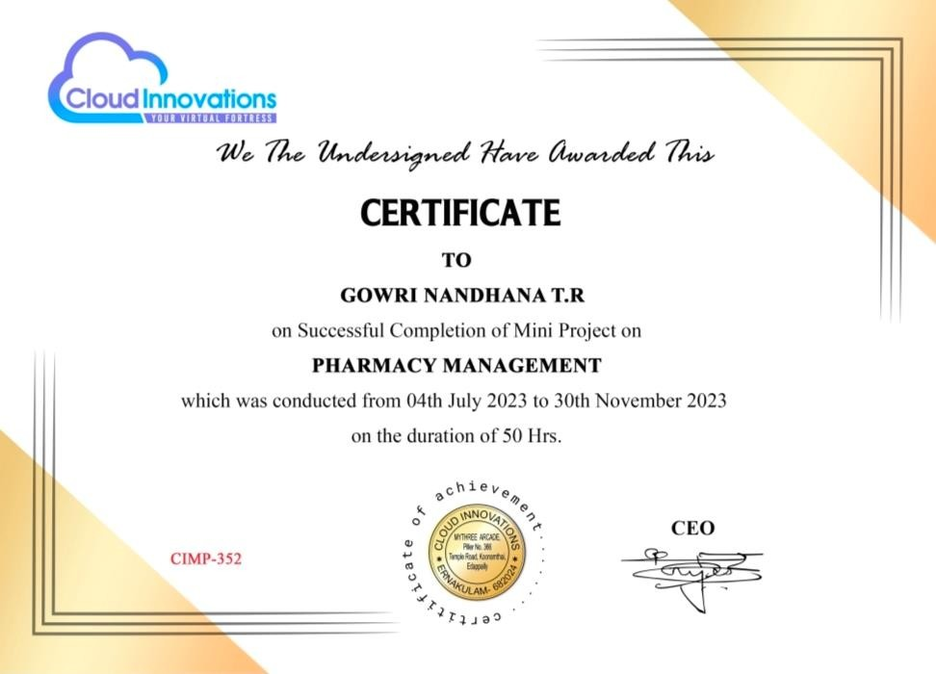

Slide 5
DECLARATION
I, Seethal V . S ,hereby declare that the project report titled "HOME” done at LCC Project Centre, Aluva is a bonafide record of independent work carried out by me under the guidance of Ms.Anjana RR, Asst.Professor , Department of Computer Applications , in partial fulfillment of the requirement of Bachelor of computer Applications of Mahatma Gandhi University.
Place :
Date :
SEETHAL V.S

Slide 6
ACKNOWLEDGEMENT
It gives me immense pleasure to express sincere thanks to all those who helped me in the successful completion of this project work. First of all I would like to thank the Lord who gave me wisdom and enabled me to complete this Project successfully.
I express my sincere and heartfelt thanks to our beloved Principal for providing
necessary facilities for the completion of my Project successfully.
I express my sincere gratitude to the Head of Department of Computer Science , for their guidance , valuable suggestions, and support to complete the project in a systematic way.
I express my heartiest thanks and deep indebtedness to M s . A n j a n a RR project guide and Asst. Professor of Department of Computer Applications for his/her valuable guidance and encouragement throughout our course and at the time of my project work.
Last but not least I wish to extend my sincere gratitude to my parents and for the friends support and co-operation they rendered to me to make this project perfect in its total. Finally, I convey my thanks to all who helped me directly and indirectly to carry out this project successful.
SEETHAL V.S

Slide 7
INDEX
Sl.No. | Contents | Page No.
1 | INTRODUCTION | 1
 | 1.1 Abstract | 2
 | 1.2 Modules and Description | 3
2 | DEVELOPING TOOLS | 4
 | 2.1 Introduction to PHP | 5
 | 2.2 Features of Language | 6
 | 2.3 Operating System | 7
 | 2.4 Database Specification | 9
3 | SYSTEM ANALYSIS | 13
 | 3.1 Introduction to System Analysis | 14
 | 3.2 Existing System | 14
 | 3.3 Limitation of Existing System | 15
 | 3.4 Feasibility Study | 16
 | 3.5 Technical Feasibility | 17
 | 3.6 Economic Feasibility | 18
 | 3.7 Behavioral Feasibility | 18
 | 3.8 Proposed System | 18
 | 3.9 Advantages of Proposed System | 19
4 | SYSTEM SPECIFICATION | 21
 | 4.1 Hardware Requirement | 22
 | 4.2 Software Requirement | 22
5 | DATA FLOW DIAGRAMS | 23
 | 5.1 Introduction to Data Flow Diagram | 24

Slide 8
 | 5.2 Data Flow Diagrams | 25
6 | SYSTEM DESIGN | 28
 | 6.1 Introduction to System Design | 29
 | 6.2 Input Design | 29
 | 6.3 Output Design | 30
 | 6.4 Database Design | 31
 | 6.5 Table Design | 32
 | 6.6 Process Design | 41
7 | SYSTEM TESTING | 42
 | 7.1 Introduction to System Testing | 43
 | 7.1.1 Unit Testing | 43
 | 7.1.2 Integration Testing | 44
 | 7.1.3 Validation Testing | 44
 | 7.1.4 Alpha Testing | 44
 | 7.1.5 Beta Testing | 44
8 | SYSTEM IMPLEMENTATION | 46
 | 8.1 Introduction to System Implementation | 47
 | 8.2 Implementation Plan | 48
 | 8.3 System Security and Maintenance | 50
9 | CONCLUSION | 53
10 | FUTURE ENHANCEMENTS | 56
11 | BIBILIOGRAPHY | 58
12 | APPENDIX | 60
 | 12.1 Screen Shots | 61
 | 12.2 Project Code | 68

Slide 9
Home Construction Service
1 | Page
1. INTRODUCTION

Slide 10
Home Construction Service
2 | Page
1.1Abstract
My project is entitled as HOME CONSTRUCTION SERVICE. The objective of the project is to improve accuracy and enhance safety and efficiency in a hospital pharmacy. The primary aim is to design a system using which one can perform all operations in a hospital pharmacy. The objective of the project is to develop a site using PHP as the front end and MY SQL as the back end.
The Home Management System is a comprehensive digital platform designed to simplify the complex process of home construction, renovation, and maintenance by providing a centralized solution for users to access various services. Traditionally, homeowners face challenges in coordinating with multiple contractors, sourcing materials, hiring skilled labor, and managing project timelines, which can be time-consuming and costly. This system addresses these issues by offering a one-stop solution where users can book services, make payments, track progress, and provide feedback all in one place. With features like secure payment processing, real-time updates, and a streamlined workflow for scheduling deliveries and labor assignments, the platform ensures smooth operations and transparency, enhancing user satisfaction. The proposed system aims to transform home management by creating an accessible, efficient, and user-friendly platform that caters to the modern homeowner's needs, making home projects more organized and hassle-free from start to finish.
Front End
PHP
Back End
MySQL
1.2 Modules and Description
The Home Management System is a web-based platform designed to streamline various aspects of home construction and maintenance services. This system caters to users seeking services related to new home construction, renovation, engineering consultation, cost estimation, labor hiring, and construction materials procurement.The different modules used to accomplish the needs of this system are:

Slide 11
Home Construction Service
3 | Page
Administration Module
User Module
Labour Module
Delivery boy Module
. Administration Module
These Module is the control center of the system, providing administrators with the tools to manage users, products, service requests, and feedback. Admins can approve or reject service requests, track order statuses, and manage the allocation of labor resources. They are also responsible for managing the database of products, ensuring that all materials required for construction or renovation are available. Additionally, admins oversee the activities of delivery personnel and laborers, managing their schedules and ensuring that all tasks are executed according to user requests.
User Module
The User Module provides an intuitive interface for customers, enabling them to explore a wide range of services. Users can request cost estimates, make bookings for various services, and provide feedback once tasks are completed. This module facilitates seamless payments, allowing users to manage their finances efficiently. Additionally, users can view the status of their bookings and payments, ensuring full transparency and real-time updates. This module also allows users to rate and review services, providing valuable insights for continuous service improvement
Labour Module
The Labor Module handles the hiring and management of skilled laborers, including painters, carpenters, electricians, and cleaners. Users can request specific labor services, and the module manages their availability and assignment to projects based on user requirements. Admins have the authority to approve or reject labor requests, ensuring that only qualified and vetted professionals are assigned to projects. This module also tracks the work progress of laborers and allows users to provide feedback, which helps in maintaining a high standard of service quality
Deliveryboy Module
Manages the allocation and tracking of delivery requests, ensuring timely delivery of construction materials or other ordered items.

Slide 12
Home Construction Service
4 | Page
2. DEVELOPING TOOLS

Slide 13
Home Construction Service
5 | Page
Introduction to PHP
PHP started out as a small open source project that evolved as more and more people found out how useful it was. Rasmus Lerdorf unleashed the first version of PHP way back in 1994. PHP is a recursive acronym for "PHP: Hypertext Preprocessor". PHP is a server side scripting language that is embedded in HTML. It is used to manage dynamic content, databases, session tracking, even build entire e-commerce sites. It is integrated with a number of popular databases, including MySQL, PostgreSQL, Oracle, Sybase, Informix, and Microsoft SQL Server. PHP is pleasingly zippy in its execution, especially when compiled as an Apache module on the Unix side. The MySQL server, once started, executes even very complex queries with huge result sets in record-setting time. PHP supports a large number of major protocols such as POP3, IMAP, and LDAP. PHP4 added support for Java and distributed object architectures (COM and CORBA), making n-tier development a possibility for the first time. PHP is forgiving: PHP language tries to be as forgiving as possible. PHP Syntax is C-Like. PHP performs system functions, i.e. from files on a system it can create, open, read, write, and close them. PHP can handle forms, i.e. gather data from files, save data to a file, through email you can send data, return data to the user. You add, delete, modify elements within your database through PHP. Access cookies variables and set cookies. Using PHP, you can restrict users to access some pages of your website. It can encrypt data. Five important characteristics make PHP's practical nature possible −
Simplicity
Efficiency
Security
Flexibility
Familiarity
Features of Language
Different features of languages are as follows:
License

Slide 14
Home Construction Service
6 | Page
PHP is first an interpreted scripting language (actually precompiled opcodes), free, open source and distributed under a license authorizing the modification and redistribution.
Portability
PHP is supported on multiple operating systems. This is for example the case of Microsoft Windows ™ versions as well as systems based on UNIX base (Apple Mac OS X ™, Linux or Sun Solaris).It will be very easy to move an application written in PHP an original Windows server to a Linux server without having to modify (or very little).
Execution
From a performance standpoint, PHP needs a Web server to run. All pages requested by a client will be built by the web server, depending on the parameters passed, before being returned to the client. The diagram below illustrates the principle of operation of PHP.
PHP Learning
PHP is a "high level" language whose syntax is very similar to the C language syntax. Nevertheless, the rapid control of its syntax does not mean control of its features and its concepts. A good knowledge and advanced use of PHP Programming requires a relatively long learning curve.
PHP language of wealth
One of PHP's strengths is its richness in terms of functionality. Indeed, it has at the origin of more than 3,000 native features ready-guaranteeing developers to overcome additional development time and sometimes tedious. These functions among others to treat strings, to operate mathematically on numbers, convert dates to connect to a database system, manipulate files present on the server ...
PHP also draws its richness from its vibrant developer community. It was estimated at 500 000 people in 2003, but it is very likely that it has surpassed one million now. Community developers profiles are very diverse. It there's those who bring new features and version to version libraries, those that translate the documentation in multiple languages or programmers with more modest skills that perform opensource applications ready for use. Among the best

Slide 15
Home Construction Service
7 | Page
known, we can cite the CMS (Joomla, SPIP, Dotclear, Wordpress ...), online sales systems (OSCommerce) Forums (PHPBB, IPB, vBulletin) frameworks (Zend Framework, Symfony , CakePHP, Jelix) ...
PHP, a reliable and efficient language
The language has now become a reliable language, efficient and viable. It is capable of supporting sites that sollicent millions of daily requests. Many nationally and internationally renowned companies trust it for the development of their website. We can mention among them IBM, Le Monde, Le Figaro, Club-Internet, Orange, Yellow Pages ... A recent report shows that 87% of companies use PHP.
PHP, a language designed for dynamic web applications
PHP has the main function to be specially designed for producing dynamic web applications. By definition, an "application (or page) Dynamic" is a program capable of generating a single page based on parameters passed to it.
2.3 Operating System
WINDOWS 11
Windows 11 is the latest major release of Microsoft’s windows NT operating system, released on October 5,2021. It succeed windows 10(2015)and is available for free for any windows 10 devices that meet the new windows 11 system requirements.
Windows 11 has received a mostly positive reception. Pre-release coverage of the operating system focused on its stricter hardware requirements, with discussions over whether they were legitimately intended to improve the security of Windows or as a ploy to upsell customers to newer devices and over the e-waste associated with the changes. Upon release, it was praised for its improved visual design, window management, and stronger focus on security, but was criticized for various modifications to aspects of its user interface that were seen as worse than its predecessor; some were seen as an attempt to dissuade users from switching to competing applications.

Slide 16
Home Construction Service
8 | Page
Features of Windows 11
Windows 11 introduced several new features to the Windows line, including:
Windows 11 is the revamped action center.it follows a design language that we have seen on mobile OSes.
Universal media control.
Voice Typing is among the major Windows 11 features as it makes typing much easier
and acts as a great accessibility tool.
One of the best features of Windows 11 is fluid animations across the UI.
With Windows 11, Microsoft has brought Widgets, where you can find all kinds of
information with just a click.
During the Windows 11 unveiling, Microsoft announced support for Auto HDR that would elevate the viewing experience while playing games. While we have not tried it on our system so far, it sure sounds like a great feature for the massive gaming community on Windows.
User Interface
Windows 11 features a new task-based graphical user interface. The Start menu and windows indexing service were redesigned and many visual effects were added, including:
Translucency, shadows, a new colour palette, and rounded geometry are prevalent throughout the UI
The taskbar’s buttons are center-aligned by default, and it is permanently pinned to the bottom edge of the screen; it cannot be moved to the top, left, or right edges of the screen
Task-based sidebars in Explorer windows ("common tasks")
The ability to group the taskbar buttons of the windows of one application into one button
The ability to lock the taskbar and other toolbars to prevent accidental changes
The highlighting of recently added programs on the Start menu
Shadows under menus (Windows 2000 had shadows under mouse pointers, but not menus)

Slide 17
Home Construction Service
9 | Page
2.4 Database Specification
MySQL
MySQL is a relational database system. If you can believe many diehard MySQL fans, MySQL is faster, more reliable, and cheaper -- or, simply put, better -- than any other database system (including commercial systems such as Oracle and DB2). Many MySQL opponents continue to challenge this viewpoint, going even so far as to assert that MySQL is not even a relational database system.
Features of MySQL
The following list shows the most important properties of MySQL.
Relational Database System: Like almost all other database systems on the market, MySQL is a relational database system.
Client/Server Architecture: MySQL is a client/server system. There is a database server (MySQL) and arbitrarily many clients (application programs), which communicate with the server; that is, they query data, save changes, etc. The clients can run on the same computer as the server or on another computer (communication via a local network or the Internet).Almost all of the familiar large database systems (Oracle, Microsoft SQL Server, etc.) are client/server systems. These are in contrast to the file-server systems, which include Microsoft Access, dBase and FoxPro. The decisive drawback to file-server systems is that when run over a network, they become extremely inefficient as the number of users grows.
SQL compatibility: MySQL supports as its database language -- as its name suggests – SQL (Structured Query Language). SQL is a standardized language for querying and updating data and for the administration of a database. There are several SQL dialects (about as many as there are database systems). MySQL adheres to the current SQL standard (at the moment SQL:2003), although with significant restrictions and a large number of extensions.
Views: Put simply, views relate to an SQL query that is viewed as a distinct database object and makes possible a particular view of the database. MySQL has supported views since version 5.0.

Slide 18
Home Construction Service
10 | Page
Stored procedures: Here we are dealing with SQL code that is stored in the database system.
Stored procedures (SPs for short) are generally used to simplify certain steps, such as inserting or deleting a data record. For client programmers this has the advantage that they do not have to process the tables directly, but can rely on SPs. Like views, SPs help in the administration of large database projects. SPs can also increase efficiency. MySQL has supported SPs since version 5.0.
Triggers: Triggers are SQL commands that are automatically executed by the server in certain database operations (INSERT, UPDATE, and DELETE). MySQL has supported triggers in a limited form from version 5.0, and additional functionality is promised for version 5.1.
Unicode: MySQL has supported all conceivable character sets since version 4.1, including Latin-1, Latin-2, and Unicode (either in the variant UTF8 or UCS2).
User interface: There are a number of convenient user interfaces for administering a MySQL server.
Full-text search: Full-text search simplifies and accelerates the search for words that are located within a text field. If you employ MySQL for storing text (such as in an Internet discussion group), you can use full-text search to implement simply an efficient search function.
Replication: Replication allows the contents of a database to be copied (replicated) onto a number of computers. In practice, this is done for two reasons: to increase protection against system failure (so that if one computer goes down, another can be put into service) and to improve the speed of database queries.
Transactions: In the context of a database system, a transaction means the execution of several database operations as a block. The database system ensures that either all of the operations are correctly executed or none of them. This holds even if in the middle of a transaction there is a power failure, the computer crashes, or some other disaster occurs. Thus, for example, it cannot occur that a sum of money is withdrawn from account A but fails to be deposited in account B due to some type of system error.
Transactions also give programmers the possibility of interrupting a series of already executed commands (a sort of revocation).

Slide 19
Home Construction Service
11 | Page
In many situations this leads to a considerable simplification of the programming process. In spite of popular opinion, MySQL has supported transactions for a long time. One should note here that MySQL can store tables in a variety of formats.
The default table format is called MyISAM, and this format does not support transactions. But there are a number of additional formats that do support transactions. The most popular of these is InnoDB, which will be described extensively in this book.
Foreign key constraints: These are rules that ensure that there are no cross references in linked tables that lead to nowhere. MySQL supports foreign key constraints for InnoDB tables.
GIS functions: Since version 4.1, MySQL has supported the storing and processing of two- dimensional geographical data. Thus MySQL is well suited for GIS (geographic information systems) applications.
Programming languages: There are quite a number of APIs (application programming interfaces) and libraries for the development of MySQL applications. For client programming you can use, among others, the languages C, C++, Java, Perl, PHP, Python, and Tcl.
ODBC: MySQL supports the ODBC interface Connector/ODBC. This allows MySQL to be addressed by all the usual programming languages that run under Microsoft Windows (Delphi, Visual Basic, etc.). The ODBC interface can also be implemented under Unix, though that is seldom necessary.
Windows programmers who have migrated to Microsoft's new .NET platform can, if they wish, use the ODBC provider or the .NET interface Connector/NET.
Platform independence: It is not only client applications that run under a variety of operating systems; MySQL itself (that is, the server) can be executed under a number of operating systems.
The most important are Apple Macintosh OS X, Linux, Microsoft Windows, and the countless Unix variants, such as AIX, BSDI, FreeBSD, HP-UX, OpenBSD, Net BSD, SGI Iris, and Sun Solaris.

Slide 20
Home Construction Service
12 | Page
Speed: MySQL is considered a very fast database program. This speed has been backed up by a large number of benchmark tests (though such tests -- regardless of the source -- should be considered with a good dose of skepticism).

Slide 21
Home Construction Service
13 | Page
3. SYSTEM ANALYSIS

Slide 22
Home Construction Service
14 | Page
Introduction to System Analysis
System Study refers to the process of examining a situation with the intent of improving it through better process and method. System study is, therefore the process of gathering and interpreting facts, diagnosing problem and using the information to recommend information in system or in other words, it means a detailed explanation or description. Before computerizing a system under consideration, it has to be analyzed. We need to study how it functions currently, what are the problems and what are the requirements that proposed software should meet.
The main components of making software are:
System and software requirements analysis
Design and implement of software
Ensuring, verifying and maintaining software integrity
The first step in the system study includes analysis of the system. System analysis involves studying the way an organization currently receives and processes data to produce information with the goal of determining how to make it work better. System analysis includes both a preliminary and a detailed stage. During preliminary analysis the analysts takes a quick look at what is needed and whether it benefits the perceived want. Detailed analysis includes an in depth look at what is wanted and contains more refined cost and benefits studies.
The preliminary analysis begins when someone perceives a problem, modification to an existing system, repairs to an existing system or demands an entirely new system. The analyst summarizes the gained information, including personal requirements and potential benefits of the new system in formal report called the preliminary report. Detailed analysis expands the preliminary efforts to include the complete analysis of all possible alternative solutions to the problem and complete expansion of what appears to be the most practical solution.
Existing System
The existing system uses manual methods for the whole process. In the present system a patient wants to take appointment directly from the hospital and patient can’t request for a home delivery for the prescription.

Slide 23
Home Construction Service
15 | Page
The chance of error and inaccurate data are very high. This often requires a lot of time and effort. Moreover data are to be maintained in separate files. The existing system is slow since it involves a lot of paper work and calculation. Hence, in order to keep up with the changing environment as well as provide solution to the above problem, we need to develop a new system that overcome all the present drawbacks. To overcome these problems we are implementing a computerized system with combination of
PHP and MySQL
Limitation of Existing System
The limitations of existing system is listed below,
Data Storage
In the manual system, paper files require a huge amount of storage space and paper storage creates several problems like spoilage the deterioration by way of aging, humidity etc.
Speed of Retrieval of Information
Speed of retrieval the data is less and is relatively inaccurate. Similarly speed of execution is low. It is impossible to maintain the speed and accuracy together in the manual system.
Accuracy
In the existing system the error rate is high and is difficult to locate the errors and correct them.
Time consuming
A considerable amount of time is required for recording claims in to the system. Preparing reports is a tedious task in the existing system. Thus each customer has to wait for more time.
User Friendliness
In the existing system, degree at user friendliness is considerably low. Operation
effort is high.

Slide 24
Home Construction Service
16 | Page
Backup
Backup of data cannot be done easily since all the data are in different files and are written on the paper.
Searching
Difficult to know the details of an item since we have to look through many records.
Similarly difficult to know the details.
Boring
Record the details of house members by repeating the same questions in different house boring to human beings. Computer can do such things with in seconds without having any boredom.
Based on the drawbacks and inadequacies of the existing system, the new system is designed which could rectify all the existing system. For that discussions were carried out to choose the best package for developing new systems.
3.4 Feasibility Study
A procedure that identifies, describes and evaluates the proposed system and selects the best system for the job is called feasibility study. Depending on the initial investigation feasibility study is the test of a system proposed according to its work ability impact on the organization, its ability to meet the user needs and its ability to use the resource effectively.
The feasibility study is conducted to determine if the proposed system is feasible or not. Feasibility analysis evaluates the candidate system and determines the best system that needs the performance requirements .the purpose of feasibility study is to investigate the present system, evaluate the possible application of computer based methods, select a tentative system, evaluate the cost and effectiveness of the proposed system, evaluate impact of the proposed system on existing personal and as certain the need for new personal. Feasibility is carried out to see if the system is technically, economically and operationally feasible.
All projects are feasible when given unlimited resources and infinite time. It is both necessary and prudent to evaluate the feasibility of a project at the earliest possible time. A feasibility study is not warranted for systems in which economic justifications is obvious,

Slide 25
Home Construction Service
17 | Page
technical risk is low, few legal problems are expected and no reasonable alternative exists. An estimate is made of whether the identified user needs may be satisfied using current software and hardware technologies. The study will decide if the proposed system will be cost effective from the business point of view and if it can be developed in the given existing budgetary constraints. The feasibility study should be relatively cheap and quick. The results should inform the decision of whether to go ahead with a more detailed analysis.
Feasibility study may be documented as a separated report to higher officials of the top- level management and can be included as an appendix to the system specifications. Feasibility and risk analysis is related in many ways. If there is more project risk then the feasibility of producing the quality software is reduced.
There are mainly three considerations involved. They are,
Technical feasibility
Economic feasibility
Behavior feasibility
3.5 Technical Feasibility
Technical feasibility centers on the existing computer system and to what it can support the proposed system. Sometimes running another application could overload the system or require additional hardware.
The proposed system should need a computer as a technical device. Necessary hardware and software should be provided for the implementations. It also helps in easy storage and retrieval of data.

Slide 26
Home Construction Service
18 | Page
Economic Feasibility
Economic feasibility is the most frequently used method for evaluating the effectiveness of a system. A system can be developed if it is profitable to the organization. The procedure is to determine the benefits and savings that are expected from the candidate and compare them with cost. Most commonly this is also known as cost benefit analysis. This method is used for evaluating the system.
Manual system is highly cost driven due to the need for buying file materials and offers no
security.
The proposed system eliminates these problems. Thus the system is economically feasible.
Compared to the existing system, the proposed system doesn't involve paper works. Thus the cost of buying stationary things like files, records and other miscellaneous items can be reduced to certain extend. The proposed system doesn't require any special hardware for this work. Thus cost of buying extra hardware can be reduced.
Behavioral Feasibility
Staff and personal react positively as computer application will decrease their workload and there is no chance for loss of job for any of the employees. As a result the new system gets encouragement from the employees. But we have to do a little work to educate the user for working with the new census automation system. Therefore the proposed system is behaviorally feasible.
Proposed System
This system solves the problems existing in the manual functioning and tries to resolve them by the computerization of the Pharmacy Management System. The proposed system is a web based application and maintains a centralized repository of all related information. This software was developed with PHP as the front end and MySQL as the back end to make it more user friendly and to reduce the workload. The proposed system provides the pharmacy to meet the requirements of the patients without any hindrance.

Slide 27
Home Construction Service
19 | Page
Users can book appointments to the doctors available in the hospital and request for delivery of medicines. Doctors can write prescriptions and send directly to the pharmacy. Since the proposed system overcome all disadvantages of existing system and provide users to feel better and good.
3.9 Advantages of Proposed System
The advantages of proposed system are,
Accuracy
Once the details are added into the system, it is not necessary to enter it again. This reduces the chance of error by reducing the human involved tasks. Accurate information can be made at time.
Decision making
The proposed system assists in the decision making process producing reports at the right time. The new system allows us to make the reports depending upon a particular member and house
Data storage
A database allows centralized storage of data, thereby eliminating the redundancy of file. Searching can be made fast. The stored data is portable and flexible for future enhancements.
Data collection
Methods for collecting data are faster and more efficient. Retrieval of information is faster than the existing system manipulation is also done in an effective manner.
Speed of Response
The time required for information to be available is greatly reduced without affecting
the accuracy of the system. Manual works involve wastage of time.

Slide 28
Home Construction Service
20 | Page
User Friendliness
The user friendliness is very high when compared to the manual system. The user can do the operations without the average of the complex of the inner details. New system screens are made user friendly. It reduces the workload of the employees.
Queries
By using queries data can be accessed subject to some condition.
Cost Optimum
The implementation of a computer system results in optimizing the overall expense associates with the manual system.

Slide 29
Home Construction Service
21 | Page
4. SYSTEM SPECIFICATION

Slide 30
Home Construction Service
22 | Page
4.1 Hardware Requirement
The selection of hardware configuration is a very important task related to the software development, particularly inefficient RAM may effect adversely on the speed and corresponding on the efficiency of the entire system. The processor should be powerful to handle all the operations. The hard disk should have the sufficient capacity to solve the database and the application. The network should be efficient to handle the communication fast.
CPU
Memory
Cache
: PENTIUM III Processor
: 128 MB
: 512KB
4. Floppy Disk : 1.44MB
:4.3GB
: 15” Monitor
:Standard 108 keys Enhanced Key Board
Hard Disk
Display
Key Board
8. Mouse :MS Serial Mouse
Software Requirement
Operating System: Windows XP, 7, 8 or above
2. Front Tool
: PHP
3. Back End Tool: MySQL

Slide 31
Home Construction Service
23 | Page
5. DATA FLOW DIAGRAMS

Slide 32



Home Construction Service
24 | Page
Introduction to Data Flow Diagram
The first step is to draw a data flow diagram (DFD).A DFD also known as “bubble chart”, has the purpose of clarifying system requirements and identifying major transformation that will become programs in system design. So it is starting point of the design phase that functionally decomposes the requirements specification down to the lowest level of details DFD consists of series of bobbles joined by lines. The bubbles represent data transformation and the lines represent data flow in the system.
DFD Symbols
In DFD there are four symbols,
A square defines a Source (originator) or Destination of system data.
2. An arrow identifies Data flow in motion. It is a pipeline through which information follows.
3. A circle or a “bubble” represents a Process that transforms incoming data flow into outgoing dataflow.
4. An open rectangle is a Data store-data at rest, or a temporary repository of data.

Slide 33
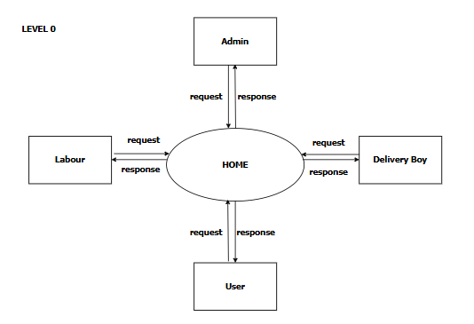
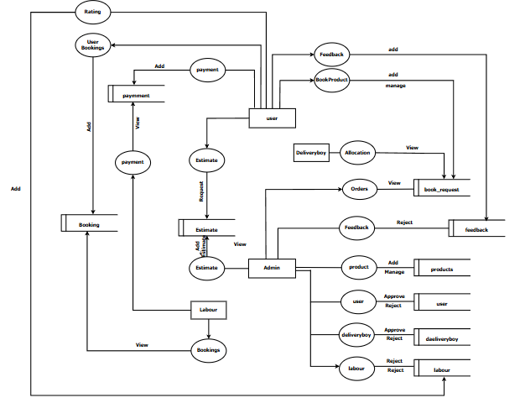
Home Construction Service
25 | Page
5.2 Data Flow Diagrams
LEVEL 0 DFD: PHARMACY MANAGEMENT SYSTEM
LEVEL 1 DFD: PHARMACY MANAGEMENT SYSTEM

Slide 34
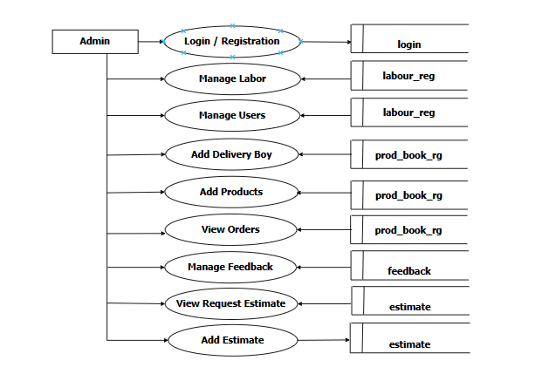
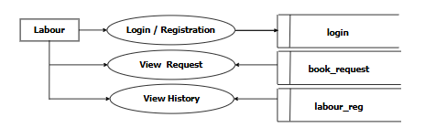
Home Construction Service
26 | Page
LEVEL 2 DFD FOR ADMIN
LEVEL 2 DFD FOR LABOUR

Slide 35
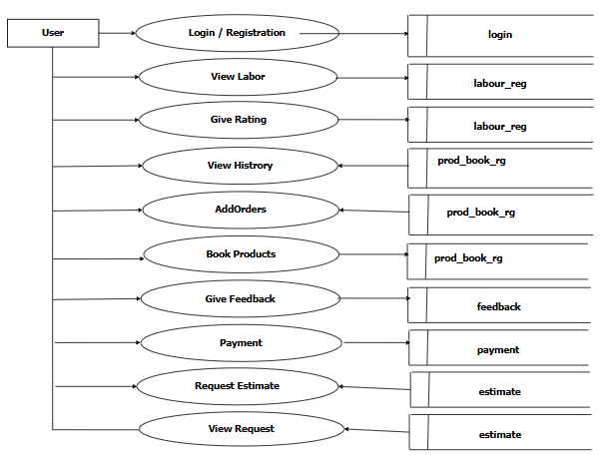

Home Construction Service
27 | Page
LEVEL 2 DFD FOR USER
LEVEL 2 DFD FOR DOCTOR

Slide 36
Home Construction Service
28 | Page
6. SYSTEM DESIGN

Slide 37
Home Construction Service
29 | Page
Introduction to System Design
System design deals with planning and designing of the system. It is a solution that is the transaction of requirements into ways of meeting them.System designing is the process of defining the architecture, components, modules, interfaces and data for a system to satisfy specified requirements. It is a solution to a “how to” approach compared to system analysis which is a “what is” orientation. It translates the system requirements into ways of making them operational. The design phase focuses on the detailed implementation of the system recommended in the feasibility study.
The design will determine the success of the system. It mainly deals with form design, screen design and database design .it is the transaction of a user oriented document to document oriented programmers or database personnel. The goal of the design process is produce a model or a representation of a system, which can be used later to build that system. The produced system is called the design of the system.
The term design describes a final system and the process by which it is developed .It refers to the technical specification that will be applied in implementing the system. It is the most creative and challenging phase of the system development life cycle. Design process begins by identifying reports and other outputs the system will produce.
The system design also describes the data to be given as input, calculated or stored. Individual data item and calculation procedure are written in details. The “MEDCARE” is designed in such a way that the input and output designer are very user friendly.
Input Design
Input is the process of converting user inputs into computer based format. The project requires a set of information from the user to prepare a report. In the order, when organized input data are needed. Inaccurate input data are the most common cause of errors in data processing. Errors entered by data entry operators can be controlled by input design. Input design is the process of converting user originated inputs to a computer based format. The goal of designing input data is to make data entry as easy, logical and free from errors as possible.

Slide 38
Home Construction Service
30 | Page
The input design is the link between the information system and the user. it involves determining how to facilitate the user with an interactive and friendlier environment it comprise the developing specification and procedure for the preparation and those steps that are necessary to put transaction data into usable form for processing data entry. The design of inputs focused on controlling the amount of input required, controlling the errors, avoiding delay, avoiding extra steps and keeping the process simple. Input screen of the system including screens for data entry, screen for entering the master definition etc. The objective of efficient screen design is to facilitate user friendliness and interactive ness providing with adequate help to the user.
In the system, efforts were taken so as to control the amount of input so as to avoid errors in data and to make the system simple and comfortable to the user.
Objectives
To produce a cost-effective method of input.
To achieve the highest possible level of accuracy.
To ensure that the input is acceptable and understandable.
The following controls have been added to every form to process for the visitors desired inputs.
Text Box
Radio Button
Select Box
Password Field
Submit Button
DT Picker
These controls are used for entering the data. The forms also include the methods for passing the information to the server.
6.3 Output Design
Output design is the process of designing the output forms. Computer outputs are the most important direct source of information to be user and to the management. Efficient and eligible output design should improve the system's relationship with the user and help in

Slide 39
Home Construction Service
31 | Page
decision making. Output design generally deals with the results generated by the system i.e., reports. This report can be generated from stored or calculated values. Reports are displayed either as screen window preview or printed form. Most end users will not actually operate the information system or enter data through workstation, but they will use the output from the system. Outputs from computer system are required primarily to communicate the results of processing to the user.
The standards for printed output suggest the following:
Give each output a specific name or title.
Specify the procedure for providing the accuracy of output data
Arrange the presentation of information in an acceptable format.
Depending on the nature and future use of output required, they can be displayed on the monitor for immediate need and for obtaining the hardcopy.
6.4 Database Design
Database design the general theme behind a database is to handle information as an integrated whole. A database is a collection of interrelated data stored with minimum redundancy you serve many quickly and effectively. The database is a collection of stored data organized in such a way that all the data requirements are specified by the database. Database design is crucial to effectively implement a relational database. A relational Database Management system consist of a collection of interrelated data and a set of programs to access that data. The management of data involves both the definition of structures for the storage of information and provision of mechanisms for the manipulation of information. The collection of information stored in the database at a particular moment of time is called an instance of the database.
The aim of database design is to improve the existing system situation .The number of database files were designed to hold the data requirements for running their systems.
There is none of the artificially that is normally embedded in separate files or applications. In database environment common data’s are available with several authorized users can use. The concept behind a database is an integrated collection of data and provides a

Slide 40
Home Construction Service
32 | Page
centralized access to data from the program. It makes possible to treat data as a separate resource. While database, several objectives must be considered:
Controlled redundancy
Data independence
Accuracy and integrity
Recovery from failure
Privacy and security
Performance
Table Design
Table design refers to how the logical data structures are to be physically stored in the storage device. The design of table includes decision making on th nature and content of the files such as whether it is to be used for storing master details, transaction details or reference information. Various factors are considered during the table design phase of system analysis. Some of them are listed below:
Purpose of the table
Availability of the hardware
Method of access
File activity
File size
Output requirements
Input requirements
File organization
Table design also deals with the design of physical database. The designing of the tables in the database is done according to the rules specified for databases as described above. Inaccurate input data are the most common cause of errors in data processing.

Slide 41
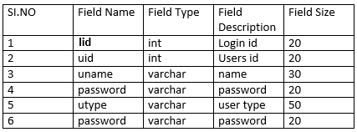
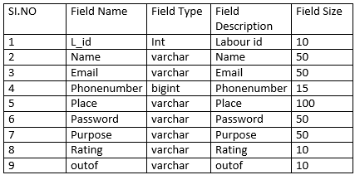
Home Construction Service
33 | Page
LOGIN TABLE
Table Name
Table Description
Primary Key
: login
: This table stores login details
: email
Foreign Key
: Null
LABOUR TABLE
Table Name
Table Description
Primary Key
: labour_reg
: This table stores doctor details
: id(doctor_id)
Foreign Key
: user_id(references users table)

Slide 42
Home Construction Service
34 | Page
USER TABLE
Table Name Table Description
: pharmacies_tbl
: This table stores pharmacist details
: id(pharma_id)
:user_id(references users table)
Primary Key
Foreign Key
MEDICINE STOCK TABLE
Table Name
Table Description
Primary Key
: medicines_stocks_tbl
: This table stores medicine stock details
: id(medicine_stock_id)
: pharma_id, medicine_id(references pharmacies and medicine table)
Foreign Key
Sl.No | Field Name | Field Type | Field Description | Field Size
1 | id | int | Medicine id | 5
2 | pharma_id | int | Package id | 5
3 | medicine_id | int | Medicine id | 5
4 | quantity | int | Medicine quantity | 5
5 | description | text | description | 20

Slide 43
Home Construction Service
35 | Page
MEDICINES TABLE
Table Name : medicines_tbl
_{Table Description} : This table stores medicines
details
: id
:
Primary Key
Foreign Key
pharmacies table)
pharma_id(references
Sl.No | Field Name | Field Type | Field Description | Field Size
1 | id | int | Medicine id | 3
2 | pharma_id | int | Pharmacy id | 3
3 | product_code | int | Medicine code | 50
4 | name | varchar | Medicine name | 50
5 | price | int | Medicine price | 50
6 | current_stock | int | Stock available | 50
7 | description | varchar | Description about medicine | 50
8 | status | varchar | Active/inactive | 20

Slide 44
Home Construction Service
36 | Page
APPOINMENTS TABLE
Table Name
: appointments
_tbl
_{Table Description} : This table stores appointment
details
Primary Key Foreign Key
: id
: user_id(references user table),doctor_id(references doctor table),patient_id(references patient table)
Sl.No | Field Name | Field Type | Field Description | Field Size
1 | id | int | id | 5
2 | doctor_id | int | Doctor id | 10
3 | patient_id | int | Patient id | 10
4 | user_id | int | User id | 10
5 | name | varchar | Name of the patient | 50
6 | email | varchar | Email id | 20
7 | phone | varchar | Phone number | 20
8 | dob | date | Date of birth | 10
9 | appointment_date | date | Appointment Date | 10
10 | reason | text | Reason for visit | 50
11 | approve_status | varchar | Accept/reject/pen ding | 10

Slide 45
Home Construction Service
37 | Page
PRESCRIPTION TABLE
Table Name | : prescriptions_tbl
Table Description | : This table stores prescription details
Primary Key | : id(prescription_id)
Foreign Key | : doctor_id(references doctors table),user_id(references user table)
Sl.No | Field Name | Field Type | Field Description | Field Size
1 | id | int | id | 5
2 | doctor_id | int | doctor id | 5
3 | user_id | int | Patient’s user id | 5
4 | spec | varchar | specialization | 20
5 | name | varchar | Patient name | 20
6 | age | int | Patient’s age | 5
7 | weight | int | Patient’s weight | 10
8 | gender | varchar | Patient’s gender | 10
9 | prescription | text | Prescriptions | 50
10 | advice | text | Advices for patients | 50
11 | approve_status | varchar | Approve/reject | 10

Slide 46
Home Construction Service
38 | Page
MEDICINE ORDERS TABLE
Table Name | : medicines_orders_tbl
Table Description | : This table stores medicine orders details
Primary Key | : id
Foreign Key | :user_id,patient_id,pharma_id,medicine_id
,doctor_id.(references from user table,patient table,pharmacies table,medicines table,doctor table)
Sl.No | Field Name | Field Type | Field Description | Field Size
1 | id | int | Id | 5
2 | order_id | int | Order Id | 5
3 | pharma_id | int | Pharmacist Id | 5
4 | doctor_id | int | Doctor id | 10
5 | patient_id | int | Patient id | 10
6 | user_id | int | User id | 10
7 | medicine_id | int | Medicines id | 5
8 | quantity | int | Quantity of medicines | 5
9 | price | int | Medicine price | 20
10 | total | int | Amount | 20
11 | approve_status | varchar | Show/no show | 50
12 | payment_method | varchar | COD/PREPAID | 20
13 | order_status | varchar | Delivered/cancelled | 20
14 | payment_status | varchar | Paid/unpaid | 10

Slide 47
Home Construction Service
39 | Page
PATIENTS TABLE
Table Name Table
: patients_tbl
Descriptiondetails
: This table stores patient
Primary Key Foreign Key
: id(patient_id)
: user_id(references user table)
Sl.No | Field Name | Field Type | Field Description | Field Size
1 | id | int | patient id | 5
2 | user id | int | User id | 20
3 | name | varchar | name | 50
4 | email | varchar | Email id | 20
5 | mobile | varchar | Mobile number | 10
6 | dob | date | Date of birth | 20
7 | gender | varchar | Patient’s gender | 20
8 | address | text | address | 50
9 | status | varchar | Active/inactive | 10

Slide 48
Home Construction Service
40 | Page
DELIVERY ADDRESS TABLE
Table Name
Table Description
Primary Key
: delivery_address_tbl
: This table stores delivery
address details
: id
:user_id,patient_id(references user table,patient table)
Foreign Key
Sl.No | Field Name | Field Type | Field Description | Field Size
1 | id | int | Id | 5
2 | user_id | int | User id | 20
3 | patient_id | int | Patient id | 20
4 | name | varchar | Patient name | 20
5 | email | varchar | Email id | 20
6 | phone | varchar | Phone number | 20
7 | city | varchar | Patient’s city | 30
8 | address | varchar | address | 50
9 | post_office | varchar | Post office | 20
10 | pin_code | varchar | Pin code | 20
PAYMENTS TABLE
Table Name Table description
Primary key
Foreign key
:payments_tbl
:this table stores payment details
:id(payment_id1)
:order_id(references order table)
Sl.No | Field name | Field type | Field description | Field size
1 | id | int | Payment id | 5
2 | Order_id | int | Order id | 5
3 | amount | int | Total amount | 20
4 | currency | varchar | Currency | 10
5 | status | varchar | success | 10

Slide 49
Home Construction Service
41 | Page
6.6 Process Design
The process model generally starts with a context diagram showing the system as a single process connected to external entities outside of the system boundary. This process explodes to a lower level DFD that divides the system into smaller parts and balances the flow of information between parent and child diagrams. Many diagram levels may be needed to express a complex system.
My project entitled as MEDCARE, is a multi-user application system where the user can log-in into the ADMIN, PHARMACIST , DOCTOR or PATIENT account.
Once the Admin has logged in to the Admin account,
Admin administrates over the entire activities of the System and he has the full control over what all happens in the pharmacy management system. The admin can add doctors and pharmacists who use the system. Admin is able view the stocks available in the pharmacy and the orders that placed by the patients and he can view the transactions . The administrator is the master of the system and hence can be said as the primary user of the system.
Once the pharmacists has logged in to the pharmacists account,
The pharmacists will have more duties when compared to the administrator. Pharmacist is responsible for adding medicines, re-stocking it and he can access the prescriptions. A patient can only place delivery orders only if the pharmacists accepts their prescriptions. The payments are also managed by pharmacist module.
Once the patient has logged in to the patient account,
Patient has to register first to enter into the system. After that patient can book appointments to the doctors also patients can request for the delivery of the medicines from pharmacy as per their prescriptions.
Once the doctor has logged in to doctor account
Doctor can approve or reject the appointments from the patients and can electronically
write prescriptions and send directly to the pharmacy.

Slide 50
Home Construction Service
42 | Page
7. SYSTEM TESTING

Slide 51
Home Construction Service
43 | Page
7.1 Introduction to System Testing
System testing includes verification and validation .it is the major quality control measure employed during the software development .testing a large system is a complex activity ,and so it is broken down into smaller activities .we have tested all the modules in our project separately .and run separately to detect coding errors if any. For this special test data are input for processing and the result are examined to ensure that the software does not fail.
I.e. will run according to its specification and in away users expect. This is how we performed unit testing .due to its approach dynamic testing can only ascertain the presence of errors in the program; the exact nature of the error is not usually decided by testing. The reference documents for this process are the requirement document, and the goal is to see if the software meets the requirement documents. Testing here focuses on the external behavior of the system; the internal logic of the program is not emphasized.
In “MEDCARE” the entire system was divided into small modules and test separately
i.e. each modules were tested separately and then they were integrated and tested and finally
the entire system was tested with live the data so as to find errors.
The basic types of testing procedures are:
Unit testing
Integration testing
Validation testing
Alpha testing
Beta testing
7.1.1 Unit Testing
This is the first level of testing. A unit testing focuses verification effort on the smallest unit of software design. This testing is carried out during the coding itself. In this testing step, each module is tested, for eg. in the registration password and login. Module interface is tested to ensure that the information properly flow and out of the program under test.Data consistency is tested to ensure that the data stored maintains its integrity during all steps in algorithm

Slide 52
Home Construction Service 44 | Page
execution.All independent paths are examined to ensure that all the statement in the module have been executed at least once.
Integration Testing
Integration testing is a systematic test for constructing the program structure while conducting tests to uncover errors related to interfacing. The objective is to take unit tested modules and build a program structure that has been dictated by design. The data entered in the front end is successfully stored in the back end. For eg.in the registration they entered username and password are successfully stored in the back end. This testing is conducted in the administrator module and user module.
Validation Testing
Validation testing provides the final assurance that the software meets all the functional, behaviour and performance requirements. Validation testing begins when the software functions in a manner that can be reasonably expected by the user. The interfacing errors are uncovered and corrected and final series of software functions in a manner that is reasonably expected by the user. Validation refers to the process of using software in a live environment in order to find errors. During the course of validating the system, failures may occur and sometimes the coding has to be changed according to the requirement. Thus the feedback from the validation phase generally produces changes in the software. Once the application was made free of all logical and interface errors. Inputting dummy data ensured that the software developed satisfied all the requirements of the user.
Alpha Testing
The developer in collaboration does alpha testing with the end user. The developer guides the end user all the way while observing the reaction and feedback.
Beta Testing
Beta testing release the produce to the end user. He is at liberty to proceed as the requirements dictate. The user records all the problems that are encountered during beta testing and reports these to the developer at regular intervals. As a result of this the software developer

Slide 53
Home Construction Service 45 | Page
makes modification and then prepares for the release of the software product to entire customer base.

Slide 54
Pharmacy management system
46 | Page
8. SYSTEM IMPLEMENTATION

Slide 55
Home Construction Service
47 | Page
Introduction to System Implementation
System implementation is the process of bringing the developed system into operational use and turning it over to the user. It can be the most crucial stage in achieving a successful new system and in giving the users confidence that the new system will work and be effective. Implementation is the final stage and it’s an important phase. It involves the individual programming, system testing, user training and the operational running of developed proposed system that constitute the application subsystems. One major task of preparing for implementation is education of users, which should really have been taken place much earlier in the project when they were being involved in the investigation and design work. During the implementation phase system actually takes physical shape. In order to develop a system implemented, planning is very essential. The implementation phase of the software development is concerned with translating design specification into source code.
The user tests the developed system and changes are made according to their needs. Our system has been successfully implemented. Before implementation several tests have been conducted to ensure that no errors are encountered during the operation. The implementation phase ends with an evaluation of the system after placing it into operation for a period of time. Implementation is the third phase of the system process. The three implementation are:
Implementation of a new computer system to replace an existing one.
Implementation of a modified application to replace an existing one.
Implementation of a computer system to replace a manual.
Installation is a part of implementation, concerned with the portion of application from the developing site to the site of its working. Also the links to the database are to be established from the server. While transferring the files from the current location to the destination care must be taken, so that the file paths do not change in the transfer.
Implementation Plan
For successful implementation of the system, implementation plan is necessary. Its major elements include test plan, training plans, an equipment installation plan and conversion plan.

Slide 56
Home Construction Service 48 | Page
The test plan provides for the preparation of the best and for testing the system in a planned, structured manner. Training plan is necessary to ensure that all persons who are associated with the computer related information system have the necessary knowledge and skills. An important activity related to training is management orientation. Equipment implementation activities are site preparation, equipment installation and hardware-software checkout.
Conversion is the process of initiating and performing all physical operation that results directly in the turnover of the new system to the user. There are two parts for conversion. The conversion plan is implemented throughout the development phase into the operational phase. The conversion plan includes procedural conversion, program conversion and file conversion. The change over plan also specifies the method of change from old to new system. Choices of change over methods include parallel operation, immediate replacement and physical change over. Conversion should be exciting because it is the last step before the candidate system begins to show results. A critical aspect of conversion is not disrupting the functioning of the organization. With all technical sophistication that accompanies conversion, interpersonal relations with the user staff are extremely important in implementation.
Successful implementation of the new system design is a critical phase in the system life cycle. Implementation means the process of converting a new or a revised system design into an operational one. This involves the following:
Creating computer compactable files
Training the operating staffs
Training
Training is a vital part of the computer based information system. The main aim of training is to make aware of the system concepts to users in details. The training focuses on two issues
User capabilities
Name of the system being installed
The training sections that are given to the operators and end users are different. The operators need to know the concept of system in deep. But the end user training is only

Slide 57
Home Construction Service 49 | Page
concerned with how to perform the transaction and how to access the transaction details.
There are mainly three types of training
Brain Storming Section
Seminar
Computer awareness training
Brain Storming Section: It is a method of fact finding techniques and unknowingly the participants can be made aware of various system concepts.
Seminars: In the seminar the emphasis has to lay on the various features of the system. Use of various reports input and output procedures etc. after the seminars if require a practical workshop can be organized in order to have proper control over the operational staff.
Computer Awareness Training (Technical Training):Training is given based upon the environment in which the system is running and various software environments helping the working of the system.
Post-Implementation Review
Post implementation review is conducted after the installation of the package. And it is conducted to determine how closely the new system confirms to plan. The new system performance and user specification are audited and checked for any difference.
Conversion
Implementation is the process of bringing a developed system into operational use and turning it over to the user. Implementation activities extend from planning through conversion from the old system to the new. At the beginning of the development phase a preliminary implementation plan is created to schedule and manage the many different activities that must be integrated into the plan.
The term implementation has different meaning, ranging from the conversion of basic application to a replacement of a system. Implementation is used here to mean the process of converting a new or revised system designed to operational one.

Slide 58
Home Construction Service
50 | Page
System Security and Maintenance
Even though the changeover of the system is fully correct and complete, it is not the end of the matter. The system should be given proper security and maintenance in order to keep them efficient and up-to-date.
System Maintenance
This software can be modified as need occurs. Maintenance includes all the activities after installation of the software that is performed to keep the system operational. The process of maintaining involves:
Understanding the existing software
Understand the effect of change
Test for satisfaction
Maintenance can be done to this project by simply adding the new requirements that are
the form of database the system can be modified.
The maintenance process also helps to remove an error that raise in the system even after testing process. The complexity of the maintenance task coupled with the neglect of the maintenance concerns during development makes maintenance the most costly activity in life of the system project.
The system security is for protection against fraud and disaster. To avoid unauthorized access, password protection is highly recommended while running this new system. The password has to be maintained directly and files have to be kept very confidential.
8.3.2 System Security
The security features considered while developing the system so as to avoid the errors and omissions that may lead to serious problems. The system may have to face the unwanted events called threats. Computer system secures against a particular threat if counter measures have been taken to reduce and acceptably low level amount of loss that the threat may be expected to cause over a given period of time.

Slide 59
Home Construction Service
51 | Page
Computer to be protected from the following three problems:
Loss of availability
Loss of integrity
Loss of confidentiality
These problems may adversely that affect the availability of the computer system carry out its intended task. A threat to a computer system is any events that adversely affect the one or more assets or resources, which make up the system.
An event can be any of the following:
Interruption of communication
Destruction of hardware
Modification of software
Removal of programs
Disclosure of information
There are many methods for handling a threat:
Avoid it by altering the design
Threat retention
Threat reduction(i.e. frequency of occurrence of a threat is reduced)
Database Security
The first level of security employed in this application is at the database level. SQL Server validates users at two levels:
Login authentication
Permission validation on user database.
PHP is a widely used general purpose scripting language that is especially suited for web developing . The PHP can generate dynamic page content. It can create , open , read , write , delete , and close files on server.

Slide 60
Home Construction Service
52 | Page
System Security
This project works well on Microsoft windows as well as for Linux. Both of them provide a suitable environment for the smooth functioning of the project. Windows 11 makes personal computing easy while Linux is an extremely secured operating system. Power, performance, a bright new look and plenty of help are provided when you need it. Both have it all, along with unmatched dependability and security.
Software Security
The website “MEDCARE” has its own login and password for registered members to access the system. Every time, the software is executed, login and password will be checked and if matched, authentication will be given to open the software. A normal user doesn’t need to register in website for to read news and advertisements. A member is not allowed to create other user.
Finally system and programs that have been successfully implemented are usually subjected to continuous change. The system should be made to adapt modifications and improvements to meet changing conditions. A first class maintenance effort requires the cooperation of the people served by the system or program and those responsible for maintaining it. Maintaining the good customer relations and data security contributes to the usability of computer related information system.

Slide 61
Home Construction Service
53 | Page
9. CONCLUSION

Slide 62
Home Construction Service
54 | Page
CONCLUSION
The new system has been developed to overcome the problems in the existing system. The problems were thoroughly annualized and studied to uncover all the possible troubles that can occur in the system. The new system handles all the problems of the old system. To the best of our ability, we have tried to make it more users friendly and reliable.
The system was tested with reasonably moderate volume of data to uncover errors. The software developed is implemented according to the plan. We have the latest technique to perform the work in the software developed.
I believe that the software will remain reliably running for a reasonable good period.
Package is flexible to a great extent, so in future it can be updated and make usable.
The MEDCARE system provideshelps to stores data and functionalities that organises and maintains the medication use process within pharmacies. The project is to improve accuracy and enhance safety and efficiency in a hospital pharmacy. The primary aim is to design a system using which one can perform all operations in a hospital pharmacy.
Some specific objectives with actual performance can be compared as
Elimination of duplicate files
Reduction of persons
Proper validation achieved
Proper Reports achieved
After considering the various feasible solutions, the most feasible one was selected for designing taking into consideration the time and efficiency constraints. All the efforts have been put to make sure that the system can handle the accounts processing efficiently. The performance of the system was evaluated to determine whether system achieved the results that were expected and whether the predicted benefits of the system were being realized.

Slide 63
Home Construction Service 55 | Page
The results are obtained in a timely and consistent manner. Since each process is implemented using a single module the system liable to further modifications and also provides easy maintenance. Adequate security has been provided to ensure that only authorized person could use the system.

Slide 64
Home Construction Service
56 | Page
10. FUTURE ENHANCEMENTS

Slide 65
Home Construction Service
57 | Page
FUTURE ENHANCEMENTS
The developed system is feasible and changes can be made easily. The system is done with an insight into the necessary that be required in the future. Hence, the system can maintained successfully without much rework. In the future the system can be further modified by including more features very easily.
The future trends and development that can occur with regard to this project have been taken into consideration while designing the project. The project is developed using PHP technology, which is the latest in the present scenario and hence upgrading the project would be easier in the future. The project can be future improved by including more options:
In future we can include online consultations.
We can also include streamlining billing and insurance processes.
This provide more efficiency to the system.
A fundamental paradigm shift may be occurring from rapid application development to
immediate solution construction where organisation will focus on developing web service
around their core competences. To survive from the competition each system has to produce some modification to each in the feature. New feature will provide the system a new fresh look which it can attract a lot of user.
The software is developed in PHP which makes the system more reliable and compactible with the other environment. The application proves better extensibility and flexibility for future enhancements. Any future requirement application is possible with the features guaranteed. The design of the software is in such a way that the addition of any new module if necessary is possible without affecting the integrity of the present system.

Slide 66
Home Construction Service
58 | Page
11.BIBILIOGRAPHY

Slide 67
Home Construction Service
59 | Page
BIBILIOGRAPHY
Software Engineering (Third Edition), K K Aggarwal, YogeshSingh, New Age International Publications.
Software Engineering (7th Edition), Ian Sommerville, Pearson Education
An Integrated approach to Software Engineering (Second Edition), PankajJalote, Narosa Publication Company, Pearson Education.
Internet & Web Technologies, Raj Kamal, Tata McGraw.
Web Programming (3rd Edition), Chris Bates, N John Wiley & Sons.

Slide 68
Home Construction Service
60 | Page
12.APPENDIX

Slide 69
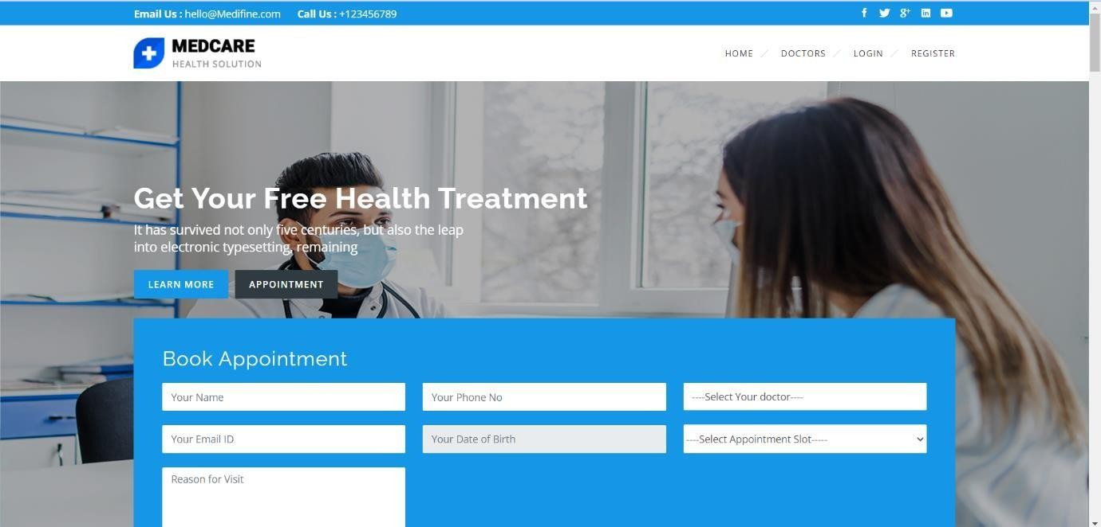
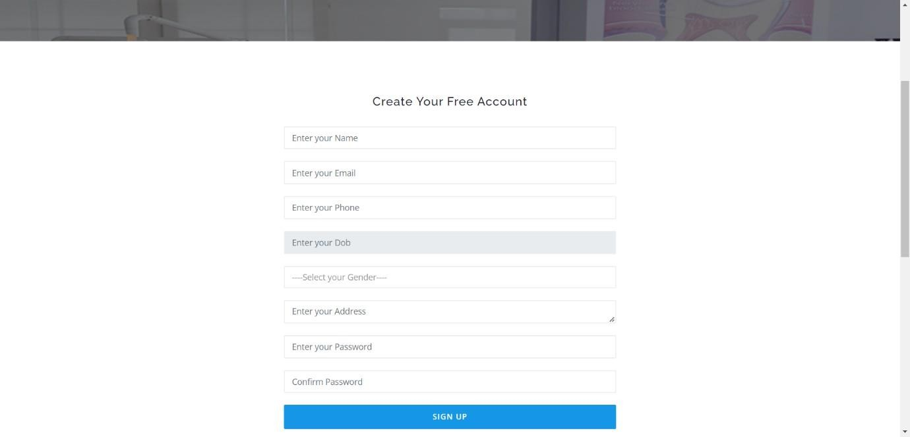
Home Construction Service
61 | Page
12.1 Screen Shots
PHARMACY MANAGEMENT SYSTEM HOME PAGE
PATIENT REGISTRATION

Slide 70
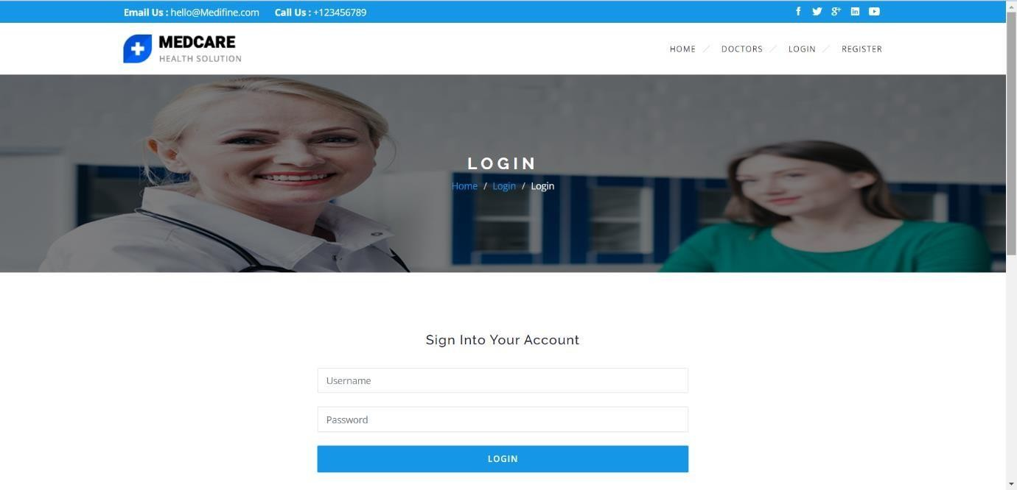
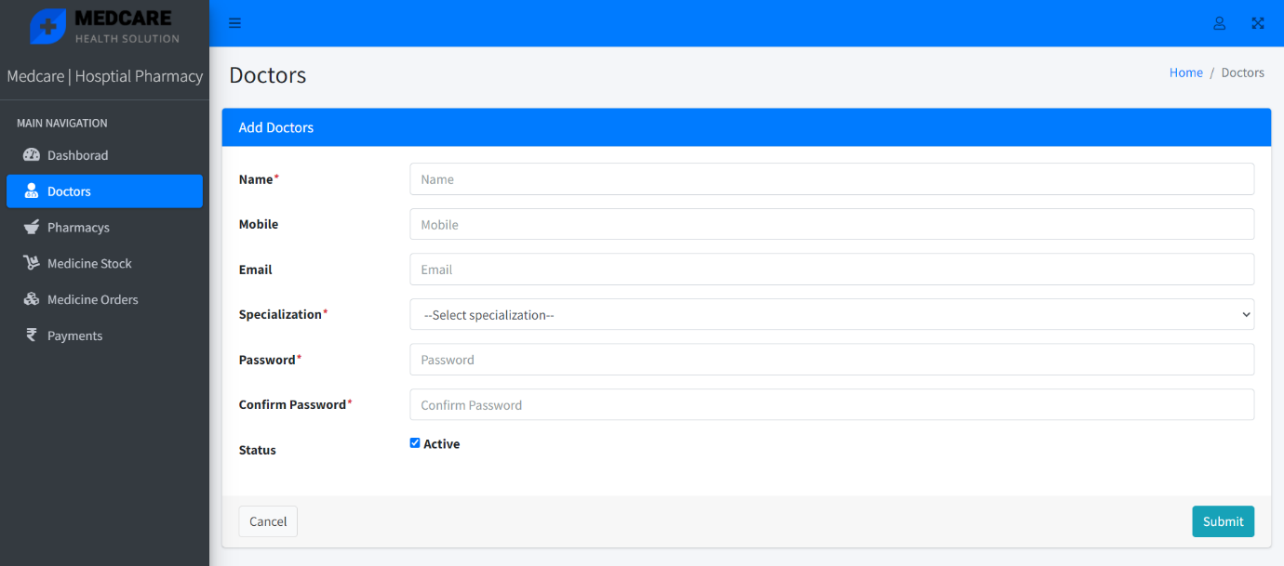
Home Construction Service
62 | Page
PATIENT LOGIN
ADMIN ADDING DOCTORS

Slide 71
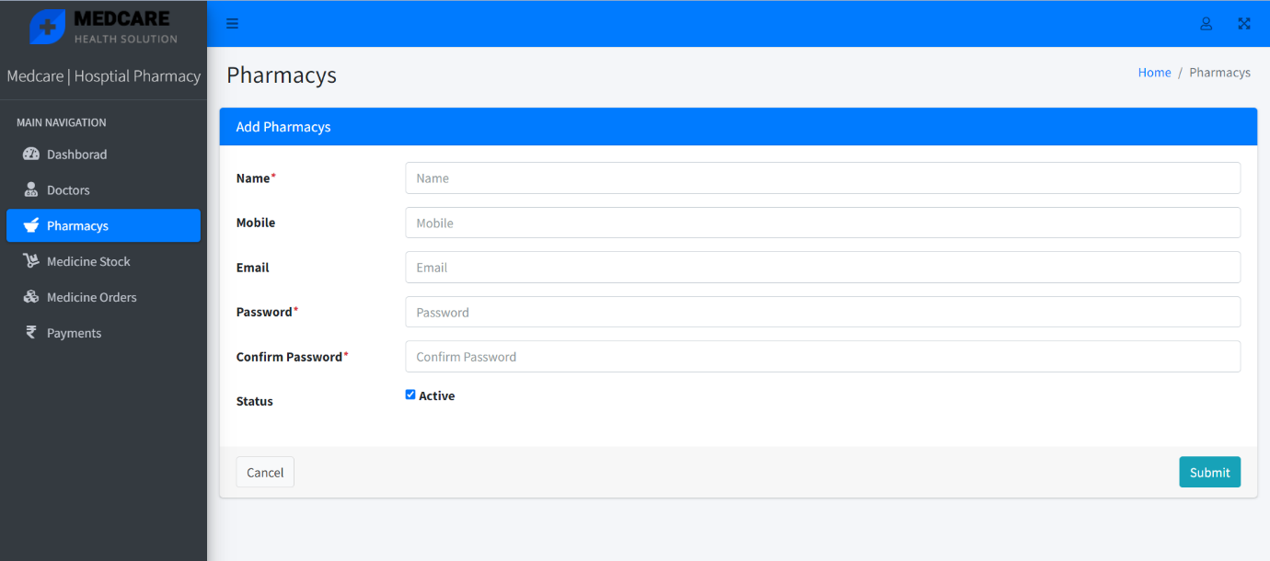
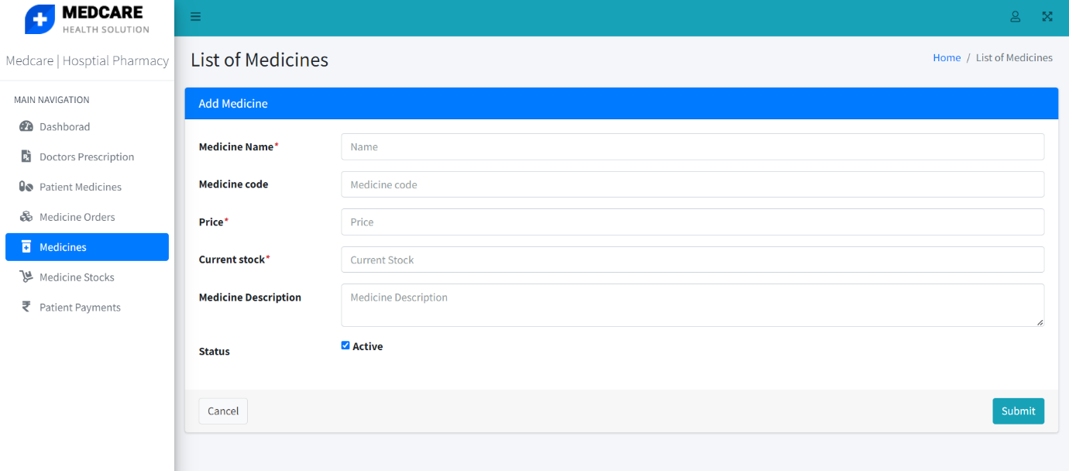
Home Construction Service
63 | Page
ADMIN ADDING PHARMACISTS
PHARMACIST ADDING MEDICINES

Slide 72
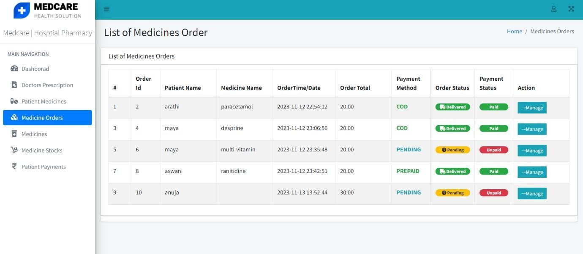
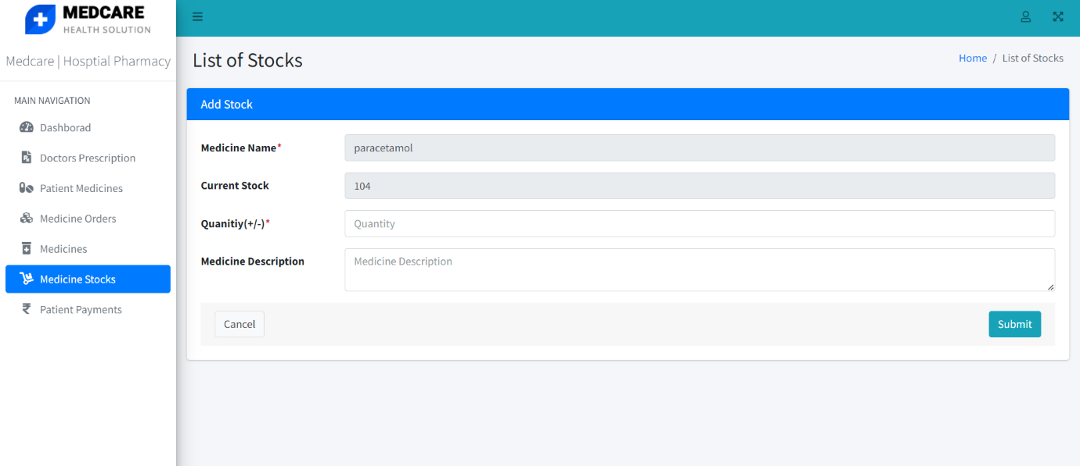
Home Construction Service
64 | Page
PHARMACIST MANAGING ORDER REQUESTS
PHARMACIST RE-STOCKING MEDICINES

Slide 73
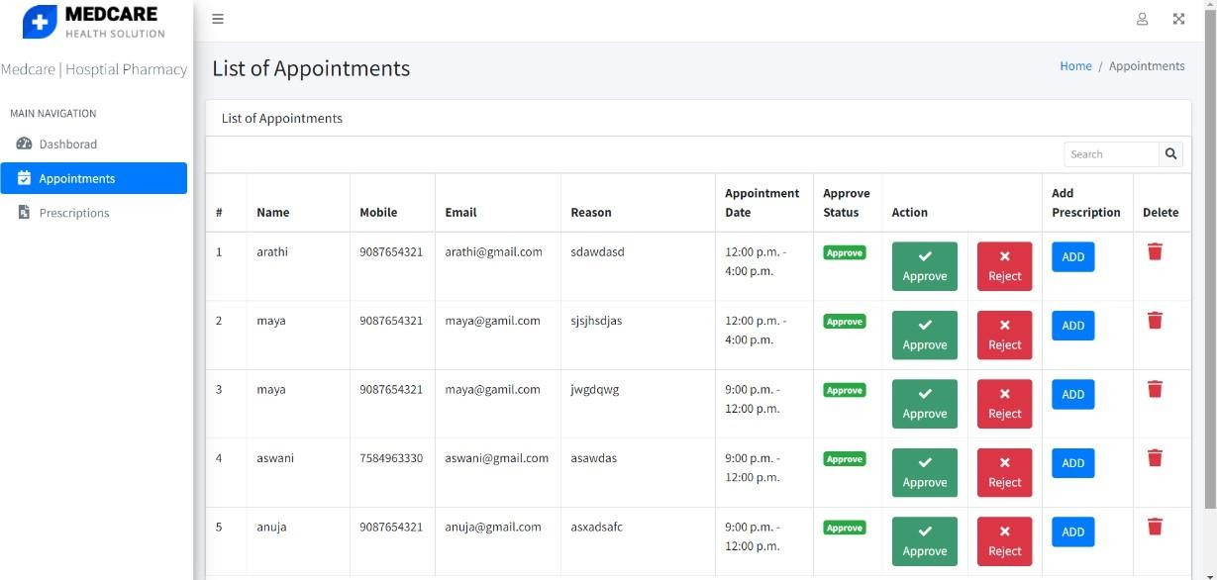
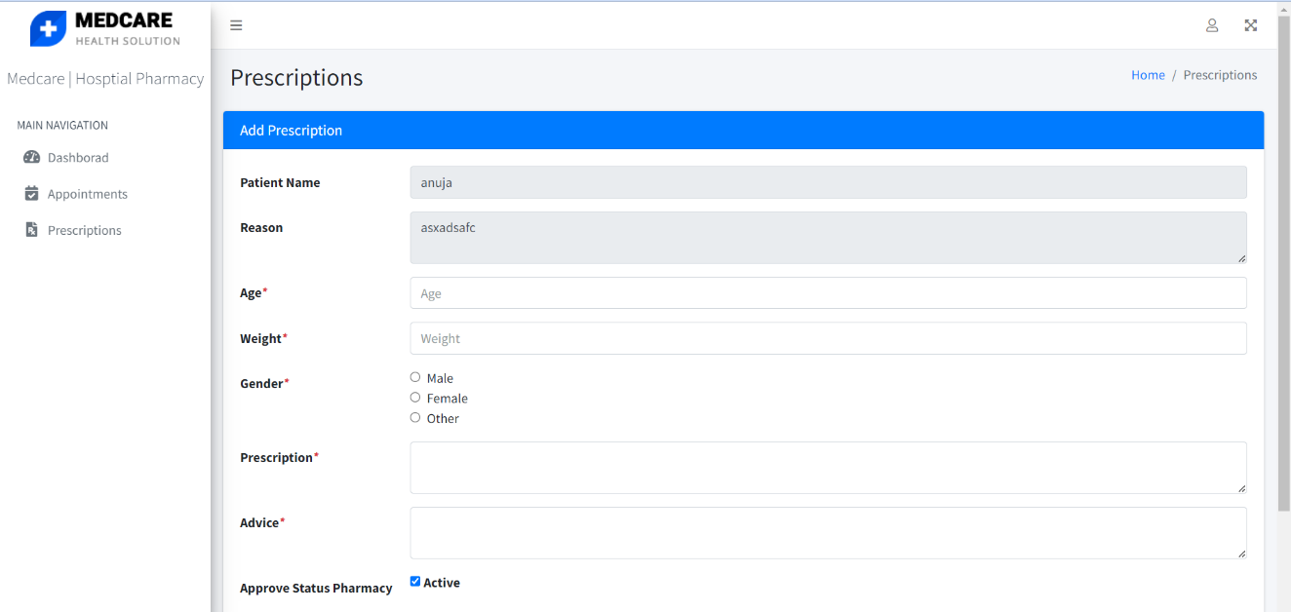
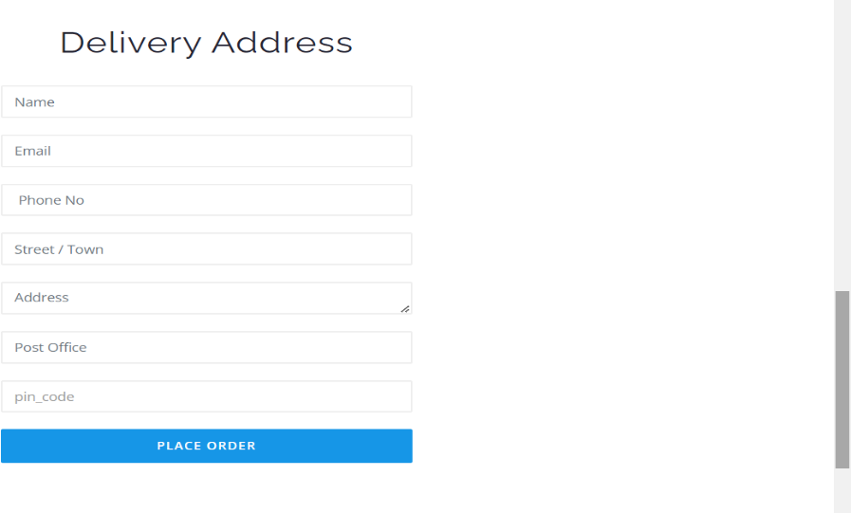
Home Construction Service
65 | Page
DOCTOR CHECKING APPOINTMENTS
DOCTOR’S PRESCRIPTIONS
PATIENT’S REQUEST FOR MEDICINE DELIVERY

Slide 74
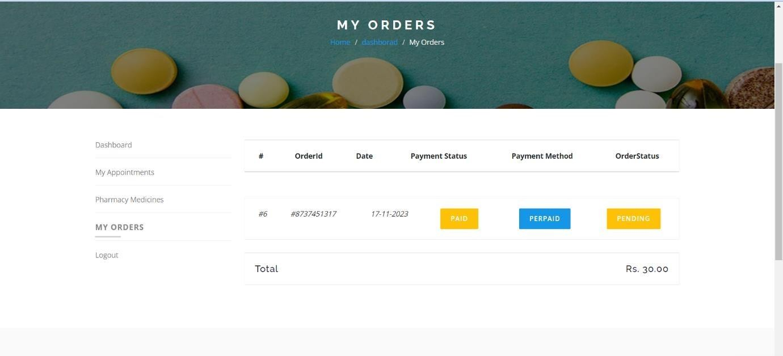
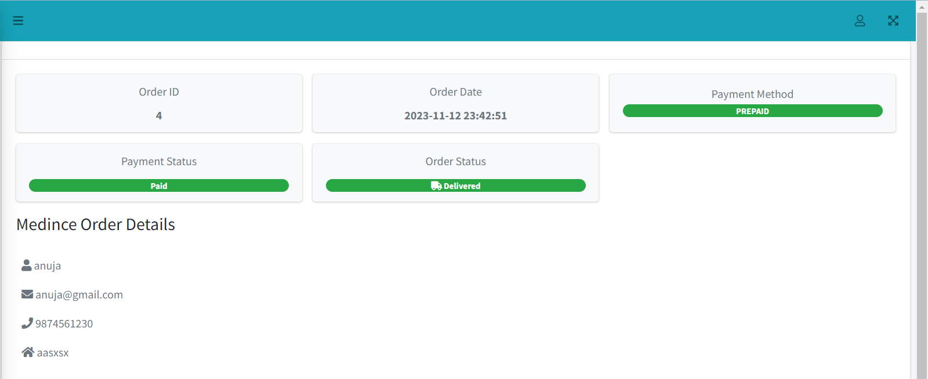
Home Construction Service
66 | Page
PATIENT ORDERS
ORDER DETAILS

Slide 75
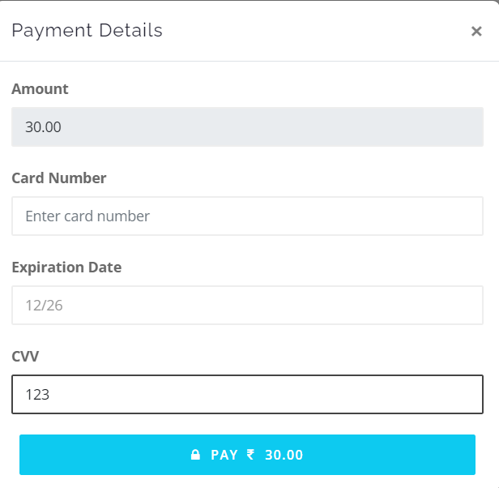
Home Construction Service
67 | Page
PAYMENT DETAILS

Slide 76
Home Construction Service
68 | Page
12.2PROJECT CODE
@extends('front.layout.defalut')
@section('content_main')
<!-- offcanvas area start -->
<div class="offcanvas area">
<div class="offcanvas wrapper">
<div class="offcanvas content">
<div class="offcanvas top mb-40 d-flex justify-content- between align-items-center">
<div class="offcanvas logo logo">
<a href="index.html">
<img src="img/logo.png" alt="">
</a>
</div>
<div class="offcanvas close">
<button class="offcanvas close-btn offcanvas-
close-btn">
<i class="fa fa-times"></i>
</button>
</div>
</div>
<div class="mobile-menu fix mb-40"></div>
<div class="offcanvas contact mt-30 mb-20">
<h4>Contact Info</h4>
<ul>
<li class="d-flex align-items-center">
<div class="offcanvas contact-icon mr-
15">

Slide 77
Home Construction Service
69 | Page
<i class="fa fa-map-marker"></i>
</div>
<div class="offcanvas contact-text">
<a target="_blank"
href="https://www.google.com/maps/place/Dhaka/@23.7806207,90.3492859,12 z/data=!3m1!4b1!4m5!3m4!1s0x3755b8b087026b81:0x8fa563bbdd5904c2!8m2!3d23.81047 53!4d90.4119873">12/A,
Mirnada City Tower, NYC</a>
</div>
</li>
<li class="d-flex align-items-center">
<div class="offcanvas contact-icon mr-
15">
<i class="fa fa-phone"></i>
</div>
<div class="offcanvas contact-text">
<a href="mailto:support@gmail.com">088889797697</a>
</div>
</li>
<li class="d-flex align-items-center">
<div class="offcanvas contact-icon mr-
15">
<i class="fa fa-envelope"></i>
</div>
<div class="offcanvas contact-text">
<a href="tel:+012-345-
6789">support@mail.com</a>
</div>
</li>
</ul>
</div>
<div class="offcanvas social">
<ul>

Slide 78
Home Construction Service
70 | Page
f"></i></a></li>
<li><a
href="#"><i
class="fa
fa-facebook-
twitter"></i></a></li>
<li><a
href="#"><i
class="fa
fa-
youtube"></i></a></li>
<li><a
href="#"><i
class="fa
fa-
linkedin"></i></a></li>
</ul>
</div>
</div>
</div>
</div>
<div class="body-overlay"></div>
<li><a
href="#"><i
class="fa
fa-
<!-- breadcrumb area -->
<div class="basic-breadcrumb-area bg-opacity style="background-image: asset('public/assets/themes/frontend/img/bg/bg-4.jpg')}}">
bg-1
ptb-100" url({{
<div class="container">
<div class="basic-breadcrumb text-center">
<h3 class="">Register</h3>
<ol class="breadcrumb text-xs">
<li><a href="index.html">Home</a></li>
<li class="active">Register</li>
</ol>
</div>
</div>
</div>
<!-- breadcrumb area -->
<!-- product-area start -->
<div class="product-area ptb-90">
<div class="container">
<div class="row justify-content-center">

Slide 79
Home Construction Service
71 | Page
<div class="col-lg-6">
<div class="account-form">
<h4 class="text-center mb-30">Create Your
Free Account</h4>
method="post">
<form
action="{{url('register')}}"
@csrf
<div class="row">
<div class="col-md-12 form-
group">
only"> Name</label>
<label
class="sr-
class="form-control input-lg" name="name" value="{{old('name')}}">
<input type="text" placeholder="Enter your Name"
</div>
<div class="col-md-12 form-
group">
only">Email</label>
<label
class="sr-
class="form-control input-lg" value="{{old('email')}}">
name="email"
<input type="text" placeholder="Enter your Email"
</div>
<div class="col-md-12 form-group">
<label class="sr-
only">Phone</label>
class="form-control input-lg" name="phone"
value="{{old('phone')}}">
<input type="text"
placeholder="Enter your Phone"
</div>
<div class="col-md-12 form-group">
<label class="sr-
only">Dob</label>
<input type="text" class="form-control input-lg" id="dob" name="dob" placeholder="Enter your Dob" value="{{old('phone')}}">
</div>

Slide 80
Home Construction Service
72 | Page
<div class="col-md-12 form-group">
<label class="sr-
only">Gender</label>
<select class="form- control input-lg" id="gender" name="gender" value="{{old('phone')}}">
<option value="">----Select your
Gender----</option>
<option value="male">Male</option>
<option
value="female">Female</option>
<option
value="other">Other</option>
</select>
</div>
<div class="col-md-12 md- form-group">
<label class="sr-
<textarea id="address" name="address" placeholder="Enter
only">Enter your Address</label>
class="form-control input-lg"
your Address">{{old('address')}}</textarea>
</div>
<div class="col-md-12 form-
group">
only">Password</label>
<label
class="sr-
name="password" Password">
class="form-control
input-lg"
<input type="password"
placeholder="Enter your
</div>
<div class="col-md-12 form-group">
<label class="sr-
only">Confrim Password</label>
name="password_confirmation" placeholder="Confirm Password">
<input type="password"
class="form-control input-lg"
</div>

Slide 81
Home Construction Service
73 | Page
group">
<div class="col-md-12 form-
<button class="btn btn-block btn-round btn-base">Sign Up</button>
type="submit"
</div>
<div class="col-sm-12 mt-30
text-center">
<p>By creating an account, you agree to our <a href="#">terms</a> and <a href="#">privacy policy</a>.</p>
<p>Already have an
account? <a href="#">Sign in!</a></p>
</div>
</div>
</form>
</div>
</div>
</div>
</div>
</div>
<!-- product-area end -->
@endsection
@section('jscript')
<script type="text/javascript">
flatpickr("#dob", {
dateFormat: "Y-m-d", // Adjust the date format as needed
});
</script> @endsection

Slide 82
Home Construction Service 74 | Page
@extends('front.layout.defalut') @section('content_main')
<!-- offcanvas area start -->
<div class="offcanvas area">
<div class="offcanvas wrapper">
<div class="offcanvas content">
<div class="offcanvas top mb-40 d-flex justify-content-between
align-items-center">
<div class="offcanvas logo logo">
<a href="index.html">
<img src="img/logo.png" alt="">
</a>
</div>
<div class="offcanvas close">
<button class="offcanvas close-btn offcanvas-close-
btn">
<i class="fa fa-times"></i>
</button>
</div>
</div>
<div class="mobile-menu fix mb-40"></div>
<div class="offcanvas contact mt-30 mb-20">
<h4>Contact Info</h4>
<ul>
<li class="d-flex align-items-center">
<div class="offcanvas contact-icon mr-15">
<i class="fa fa-map-marker"></i>
</div>
<div class="offcanvas contact-text">

Slide 83
Home Construction Service
75 | Page
<a target="_blank"
href="https://www.google.com/maps/place/Dhaka/@23.7806207,90.3492859,12z/dat a=!3m1!4b1!4m5!3m4!1s0x3755b8b087026b81:0x8fa563bbdd5904c2!8m2!3d23.8104753!4 d90.4119873">12/A,
Mirnada City Tower, NYC</a>
</div>
</li>
<li class="d-flex align-items-center">
<div class="offcanvas contact-icon mr-15">
<i class="fa fa-phone"></i>
</div>
<div class="offcanvas contact-text">
<a href="mailto:support@gmail.com">088889797697</a>
</div>
</li>
<li class="d-flex align-items-center">
<div class="offcanvas contact-icon mr-15">
<i class="fa fa-envelope"></i>
</div>
<div class="offcanvas contact-text">
<a href="tel:+012-345-
6789">support@mail.com</a>
</div>
</li>
</ul>
</div>
<div class="offcanvas social">
<ul>
<li><a href="#"><i
f"></i></a></li>
class="fa
fa-facebook-

Slide 84
Home Construction Service
76 | Page
<li><a href="#"><i class="fa fa-twitter"></i></a></li>
<li><a href="#"><i class="fa fa-
youtube"></i></a></li>
linkedin"></i></a></li>
</ul>
</div>
</div>
</div>
<li><a
href="#"><i
class="fa
fa-
</div>
<div class="body-overlay"></div>
<!-- breadcrumb area -->
<div class="basic-breadcrumb-area
bg-opacity bg-1 ptb-100" style="background-
image: url({{ asset('public/assets/themes/frontend/img/bg/bg-4.jpg')}}">
<div class="container">
<div class="basic-breadcrumb text-center">
<h3 class="">Register</h3>
<ol class="breadcrumb text-xs">
<li><a href="index.html">Home</a></li>
<li class="active">Register</li>
</ol>
</div>
</div>
</div>
<!-- breadcrumb area -->
<!-- product-area start -->
<div class="product-area ptb-90">
<div class="container">
<div class="row justify-content-center">
<div class="col-lg-6">

Slide 85
Home Construction Service
77 | Page
<div class="account-form">
<h4 class="text-center mb-30">Create Your Free
Account</h4>
method="post">
@csrf
<form
action="{{url('register')}}"
<div class="row">
<div class="col-md-12 form-
group">
Name</label>
<label
class="sr-only">
class="form-control input-lg" name="name" value="{{old('name')}}">
<input type="text" placeholder="Enter your Name"
</div>
<div class="col-md-12
group">
form-
only">Email</label>
<label
class="sr-
class="form-control input-lg" name="email" value="{{old('email')}}">
<input type="text" placeholder="Enter your Email"
</div>
<div class="col-md-12 form-group">
only">Phone</label>
<label
class="sr-
class="form-control input-lg" name="phone" value="{{old('phone')}}">
<input type="text" placeholder="Enter your Phone"
</div>
<div class="col-md-12 form-group">
only">Dob</label>
<label
class="sr-

Slide 86
Home Construction Service
78 | Page
class="form-control input-lg" id="dob" name="dob" value="{{old('phone')}}">
<input type="text" placeholder="Enter your Dob"
</div>
<div class="col-md-12 form-group">
only">Gender</label>
<label
class="sr-
<select control input-lg" id="gender" name="gender" value="{{old('phone')}}">
<option value="">----Select your Gender----</option>
<option value="male">Male</option>
<option value="female">Female</option>
<option value="other">Other</option>
</select>
</div>
<div class="col-md-12 md- form-group">
<label
only">Enter your Address</label>
class="form-
class="sr-
control input-lg" id="address" name="address" Address">{{old('address')}}</textarea>
<textarea class="form- placeholder="Enter your
</div>
<div
group">
class="col-md-12
form-
<label
class="sr-
only">Password</label>
<input type="password" name="password" class="form-control input-lg" placeholder="Enter your Password">
</div>
<div class="col-md-12 form-group">
<label class="sr-
only">Confrim Password</label>

Slide 87
Home Construction Service
79 | Page
<input type="password" input-lg" placeholder="Confirm
name="password_confirmation" Password">
class="form-control
</div>
group">
<div
class="col-md-12
form-
<button
type="submit"
class="btn btn-block btn-round btn-base">Sign Up</button>
</div>
<div class="col-sm-12 mt-30 text-
center">
<p>By creating an account, you agree to our <a href="#">terms</a> and <a href="#">privacy policy</a>.</p>
<p>Already have an
account? <a href="#">Sign in!</a></p>
</div>
</div>
</form>
</div>
</div>
</div>
</div>
</div>
<!-- product-area end -->
@endsection
@section('jscript')
<script type="text/javascript">
flatpickr("#dob", {
dateFormat: "Y-m-d", // Adjust the date format as needed
});

Slide 88
Home Construction Service
80 | Page
</script>
@endsection

